Slide 1


Information Point
Olympic Values
&
SmallSteps4Life

Slide 2
Menu
Please click any of the Olympic Rings below to navigate to the corresponding slide.
Introduction
Eat Well Information
Feel Good Information
Olympic and
Paralympic
Values
Get Active Information

Slide 3
Introduction
“You can Do It” is a project part of the Small Steps 4 Life programme. The SmallSteps4Life programme is inspired by London 2012 and promotes Olympic values amongst young people. It is about taking small steps to improve lifestyles by taking challenges to eat well, get active and feel good. The challenges last for four weeks and encourage a 'can do' attitude.
Menu

Slide 4
Olympic and
Paralympic Values
The Olympic and Paralympic Movements extend beyond the Games themselves. Athletes performing at the highest level – or in training to get there – are encouraged to live by a set of shared principles, or ways of living. These are called the Olympic and Paralympic Values.
Olympic Values:
Friendship
Excellence
Respect
SmallSteps4Life is about encouraging young people all over the country to take small manageable steps to eat well, get active and feel good. If people are getting active, this would teach them about respect for their
fellow team members and
friends – one of the Olympic
Values.
Menu

Slide 5
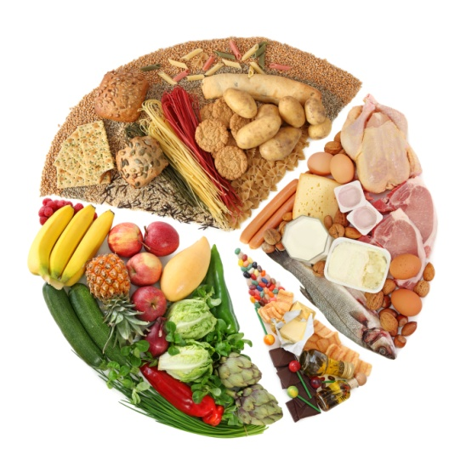
Eat Well
Information
Eating well is essential for good growth, and a healthy lifestyle. Without the necessary vitamins, minerals, amounts of protein, calcium, etc. your body may begin to suffer from malnutrition, which can cause serious health issues.
So a simple and easy way to combat this is to eat a well balanced and nutritious diet, containing sensible portions of a variety of foods, like those in the well known food wheel.
My questionnaire showed that my most popular food type was Meat, with the least popular food type being
Dairy.
Menu

Slide 6

Get Active
Information
Experts recommend a child receives on average 60 minutes of exercise 7 times a week, to make sure the body develops healthily for later life (What “SmallSteps4Life” is all about). As a person gets older, the required exercise drops to 45 minutes, 5 times a week.
Though my results showed it was apparently least important, in my audience’s view, I thought it necessary to be more important, as getting active would mean new experiences and extra curricular activities for the children.
I recommend children find a sport which they
really enjoy and then not only will they be
having fun, they will be getting healthy exercise,
sometimes without even knowing.
Menu

Slide 7
Feel Good
Information
Feeling Good about yourself and having high self esteem is something that’s highly important in order to make the most of life. Without believing in yourself and without enjoying the life you lead, it’s impossible to progress that far in your life. This is commonly referred to as our emotional health, and participating in Feel Good challenges will improve our health this way, helping to avoid feeling angry, depressed or stressed, or even relieving already existing stress and anger.
Tips and tricks for happiness:
Play an instrument, listen to some music, play computer/video games, be around happy people
such as friends, just generally CHILL!
Menu

